Slide 1
Development of an Embedded Communication Hub for the Acquisition of Sensor Data in a Robotic System
Project Thesis Juan Carlos Reyes Andrade, ICS
Rev 3 - Draft (2020.04.21)

Slide 2
Contents
Background
RTE Networks
Main goal
Specific goals
Solution proposal
Tasks table
Timeline

Slide 3
Background (draft)
Increasing robotic applications with multi-connectivity
Several Industrial Protocols in the last decades (IEC 61158 for fieldbuses except for DeviceNet and CANopen)
Industrial shift into the Real Time Connectivity
Open-source developed tools that offer compatibility with specific vendors.

Slide 4




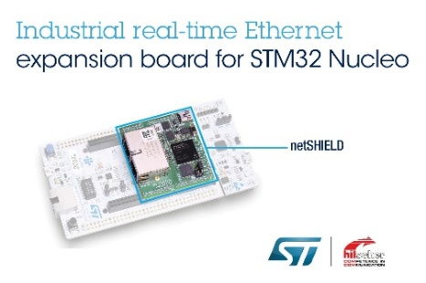



Real-Time Ethernet Networks
Started during the early 2000s (evolution of the field buses)
Referenced to IEC61784 part II
2 Strategies to ensure RT communication: TDMA and CIP (Common Industrial Protocol)
Sometimes the IEC based solutions are not longer compatible with the IEEE 802.3 Ethernet
TSN (2012) improvements within the ISO/OSI layer 2 DATA LINK (IEEE802.1Qbv)
Licensed RTE Solutions:
Open source tools:
Notes:
Started during the early 2000s (evolution of the field buses)
Referenced to IEC61784 part II *** (year?)
Examples are EtherCAT [83], Profinet [84], Ethernet/IP [85], Ethernet, Powerlink [26], and Modbus TCP [86]
2 Technics to ensure RT communication: TDMA and CIP (Common Industrial Protocol – HP -> UDP; LP -> TCP)
User perspective it is unsatisfactory, since it is only a trademark wark. Sometimes the IEC based solutions are not longer compatible with the IEEE 802.3 Ethernet Specification**
Therefore TSN (2012) official attempt to integrate the technologies to an standard, as it happened with classical Ethernet (AVB* in 2003-2005 -> industrial environments)
A set of tools that comply the international standard (mostly improvements within the ISO/OSI layer 2 DATA LINK**).
IEEE802.1Qbv implements a time slot and traffic shapping mechanism
The problem is not a synchronization problem between the EtherCAT and the TSN? Distributed clocks vs GCLs
Ethercat uses TDMA but differs with POWERLINK and Profinet IRR, difference rely within the MAC layer Telegram RT vs maibolxes NRT
Where does EtherCAT live within the OSI model? Is application layer or Network/Transport layer?
What about the PROFINET? If it sticks to ETHERNET, is it easier for it to switch to the new standard?

Slide 5
Main goal
Develop a device using open-source tools to read out sensor data from a robot axis. The device will be able to be interfaced in an RTE Network, such that it can be used afterwards as a test platform within an industrial environment to characterize its compatibility with the ongoing IEC/IEEE 60802 TSN Profile for Industrial Automation.

Slide 6
Specific goals
Analysis of requirements and needed IO interfaces for the system while taking into account the state of the art for RTE Industrial Networks
Develop the embedded system as a functional EtherCAT Slave Device with open-source tools
Integrating FreeRTOS-CMSIS with SOES
Interfacing of LAN9252 over SPI
Reading out of temperature sensors XXXX
Controlling a LED *BELT* WS2812b
Designing the required user application libraries
Design and have manufactured a PCB prototype using Altium Designer
Test and report the system functionality
Notes:
Readout of different sensors e.g. IMU (SPI), Encoders (BiSS-C),…

Slide 7

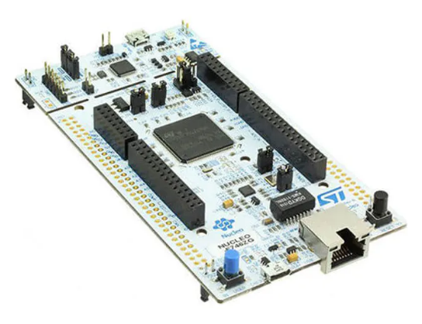
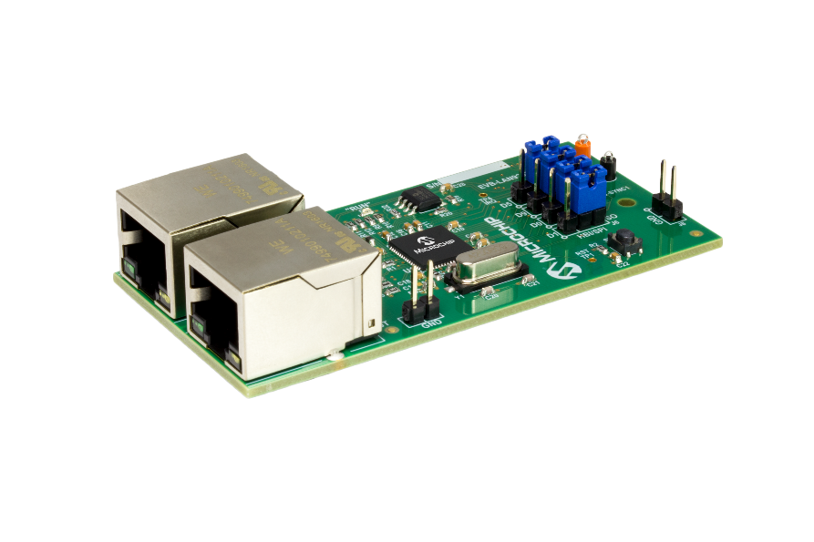

Solution proposal
Layered structure of functional blocks
Main HW: STM32Nucleo Board, Microchip LAN9252 SPI Eval Board

Slide 8
Timetable
Task Name | Duration | Start | Finish
1. Kick-Off Meeting | 1 day | Wed 29.04.20 | Wed 29.04.20
2. SW and HW Development for 1st PCB | 23 days | Thu 30.04.20 | Mon 01.06.20
3. Report of tests with 1st PCB | 1 day | Tue 02.06.20 | Tue 02.06.20
4. SW for EtherCAT comm/control features | 16 days | Wed 03.06.20 | Wed 24.06.20
5. Report of tests with EtherCAT comm/control features | 1 day | Thu 25.06.20 | Thu 25.06.20
6. SW for EtherCAT Data features | 23 days | Fri 26.06.20 | Tue 28.07.20
7. Report of tests with EtherCAT data features | 1 day | Wed 29.07.20 | Wed 29.07.20
8. HW Development for 2nd PCB | 15 days | Thu 30.07.20 | Wed 19.08.20
9. Final test with 2nd PCB | 3 days | Thu 20.08.20 | Mon 24.08.20
10 .Final presentation | 1 day | Wed 26.08.20 | Wed 26.08.20
SoSe Examination Period | 32 days | Wed 29.07.20 | Thu 10.09.20

Slide 9
Timeline
Duration: 4 Months
Official start: 29.04 Final Presentation: 26.08 (Proposal)
Final test with 2nd PCB Thu 20.08.20 - Mon 24.08.20
01 May
01 June
01 July
01 August
01 September
Start Wed 29.04.20
SW and HW Development for 1st PCB Thu 30.04.20 - Mon 01.06.20
SW for EtherCAT comm/control features Wed 03.06.20 - Wed 24.06.20
SW for EtherCAT Data features Fri 26.06.20 - Tue 28.07.20
HW Development for 2nd PCB Thu 30.07.20 - Wed 19.08.20
Finish Thu 10.09.20
SoSe Examination Period Wed 29.07.20 - Thu 10.09.20
Kick-Off Meeting Wed 29.04.20
Report of tests with 1st PCB Tue 02.06.20
Report of tests with EtherCAT comm/control features Thu 25.06.20
Report of tests with EtherCAT data features Wed 29.07.20
Final presentation Wed 26.08.20

Slide 10
Danke schön für Ihre Aufmerksamkeit!

Slide 11
Extra information

Slide 12
Main topics
Programming of software for embedded systems
STM32 MCUs with ARM architecture
Communication Interfaces (UART, I2C, BiSS, SPI)
Real Time tools (FreeRTOS - CMSIS)
Programming with industrial tools
Integration of an industrial protocol software stack into RTOS (SOES)
RT Ethernet Industrial Protocols (EtherCAT)
External configurations
EtherCAT Host (Beckhoff)
External documentations
TSN Industrial profile specification 2019

Slide 13
- [05.29] First PCB will be able to measure the temperature, interface over Uart to any serial host, control the LEDs and will only have the pinouts for SPI and BiSS connections. Tasks will be handled with a basic FreeRTOS approach. PCB will connect directly to the Nucleo and the LAN9252 Eval Board (firmly assambled, no-MCU on the manufactured board, 2X SPI Ports, 4X Temperature sensor connectors and X-Ports to LEDs).
- [06.24] First EtherCAT Slave Test - This will have at least a running framework for SPI communication, initial configuration of the LAN9252 Eval Board and a test data flow coming from the temperature sensor to the Master. It will run over the Nucleo Board.
- [07.24] Second EtherCAT Slave Test - This should exchange the data coming from sensors and saving/updating the control data coming from the Master. All the data should be structured according to the Robot application. Important to notice , the BiSS Encoder is not included in this version.
- [08.21] Second PCB - This PCB will improve the first version having the MCU considered to replace the attached Nucleo Board and adding any component that might be needed for signal instrumentation. Any code improvement could be also added to adjust the several ports considered in the PCB design.
- [08.26-28] Final Presentation - Mainly it would be focused on the integration of SOES with the RTOS to create a device that will be the base for a future performance analysis within TSNs for industrial applications. Also the current status of the TSN initiative and any discussion that might appear due to the employment of open-source tools.

